Slide 1

Foundation Project
Rose Holmes-Minton

Slide 2

Agenda
Description
Technologies
Demonstration

Slide 3
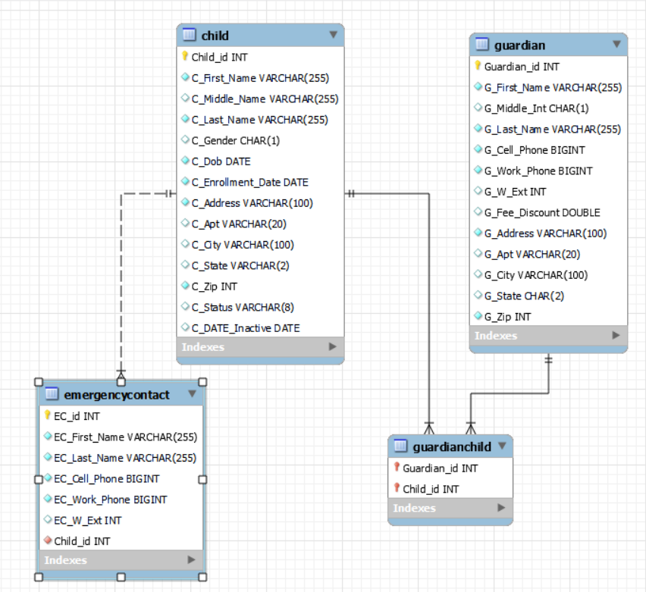
Description
Purpose
Prototype
Big Bang YOLO
Manage relevant data
Children
Guardians
Emergency contacts
Fees
Practical Use
Small daycare facility

Slide 4
Tech STACK
Python 3.10.5
Pandas
mysql.connector
MySQL 8.0
VS Code 1.6.8.1
Git /Git Hub
https://github.com/roseholmesminton/shakerdaycare/blob/main/daycare.py

Slide 5
Demonstration
Shaker Heights Discovery Center

Slide 6
Conclusion
Description
Technologies
Demonstration

